Slide 1
ANNAMALAI UNIVERSITY FACULTY OF ENGINEERING AND TECHNOLOGY DEPARTMENT OF COMPUTER SCIENCE ENGINEERING
PROJECT TITLE : “LANE AND CURVE DETECTION USING DEEP LEARNING”
TEAM MEMBERS:
1. ARUN.N
2. BALAJI.G
3. PRAVEEN.N
4. PUGAZHENTHI. K
Project Guide
(Dr.S.SARAVANAN)
Project Member
(Dr.Swami Nadhan)

Slide 2
AIM
Lane detection is the automatic driving assistance system, to avoid accidental deaths and provide a better safety on roads, by using this advanced technology.

Slide 3
OBJECTIVE
There is always a huge demand for the development of the self-driving cars since they are the future of the autonomous vehicles.
In Self-driving cars, Lane detection is considered to be the most important part in reducing the number of accidents and risks.
It is used to identify the next movement direction with the help of lines and curves on the road.
In this project, proposed a model that can detect lane in the straight and curved roads and the direction to turn the vehicle.
A hybrid deep neural network is proposed for lane detection by using multiple continuous driving scene images.
It employs with hybrid algorithm of CNN with LSTM (ConvLSTM)is proposed in this design.

Slide 4
Introduction
There is always a huge demand for the development of the self-driving cars since they are the future of the autonomous vehicles.
In Self-driving cars, Lane detection is considered to be the most important part in reducing the number of accidents and risks.
In this project, proposed a model that can detect lane in the straight and curved roads and the direction to turn the vehicle.
A hybrid deep neural network is proposed for lane detection by using multiple continuous driving scene images.

Slide 5
Proposed Methodology
A hybrid deep neural network is proposed for lane detection by using multiple continuous driving scene images.
The proposed system employs with hybrid algorithm of Convolutional Neural Networks (CNNs) and Long Short-Term Memory (LSTM) namely ConvLSTM, which is used in autonomous driving systems.
CNNs are proficient at extracting spatial features from individual frames, LSTM networks are useful for modeling temporal dependencies and capturing long-range context in sequential data.
By combining these two types of neural networks, the model can effectively leverage both spatial and temporal information for accurate lane detection in video streams.

Slide 6
Cont..
LSTM (Long Short-Term Memory) is a type of recurrent neural network (RNN) designed to address the vanishing gradient problem in traditional RNNs. It includes memory cells and gates (input, output, and forget gates) that allow it to selectively remember or forget information over long sequences.
LSTMs are effective in capturing long-term dependencies in sequential data.
ConvLSTM extends the LSTM architecture by incorporating convolutional operations into the cell state transitions and gating mechanisms.
ConvLSTM processes entire spatial regions simultaneously using convolutional filters. This is particularly useful for spatiotemporal data like videos, where both spatial and temporal dependencies are important.
ConvLSTM introduces convolutional versions of the input, output, and forget gates. These gates use convolutional filters to capture spatial patterns and relationships within the input sequence.
The convolutional operations help ConvLSTM learn spatial hierarchies and dependencies, making it well-suited for tasks where both local and global context are essential.

Slide 7
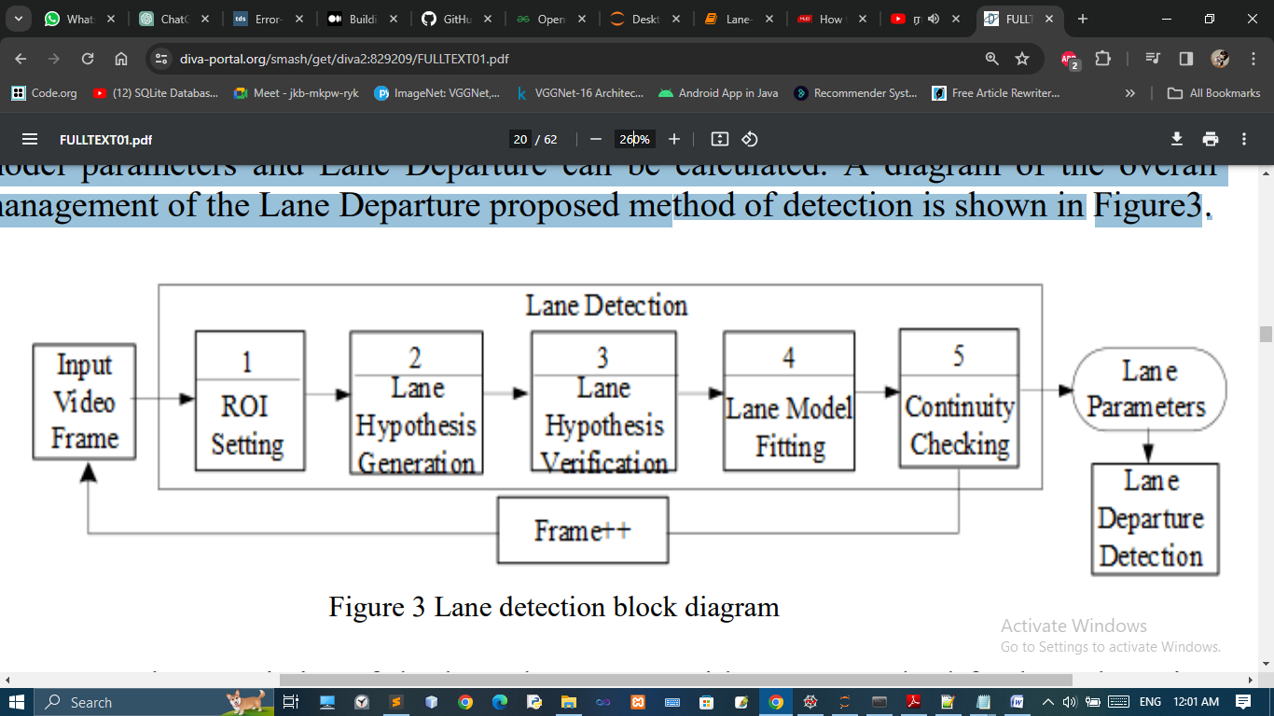
Frame to Lane Detection

Slide 8
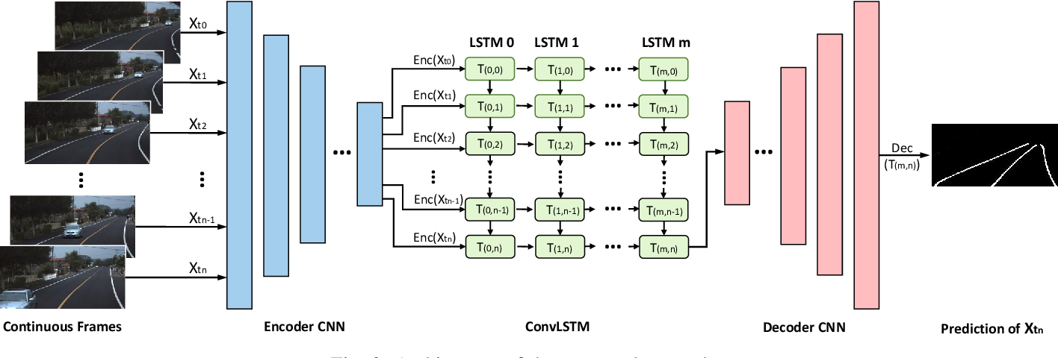
Architecture of ConvLSTM

Slide 9
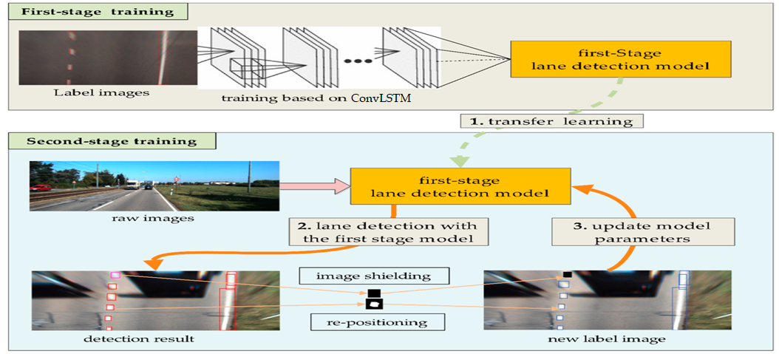
Proposed Architecture

Slide 10
HARDWARE SPECIFICATIONS
Processor : Intel I5 processor
RAM : 4 GB
Hard disk : 500 GB

Slide 11
SOFTWARE SPECIFICATIONS
Operating System : Windows 10
Language used : Python
Tools used : Anaconda (Spyder)

Slide 12
DATA COLLECTION
The TuSimple dataset consists of 6,766 road images on highways. The resolution of image is 1280×720. The dataset is composed of 3,626 for training, 358 for validation, and 2,782 for testing called the TuSimple test set of which the images are under different weather conditions.

Slide 13
Modules
Data Collection and Preprocessing
CNN Feature Extraction
Temporal Context Encoding with LSTM
Training and Evaluation
Lane Detection

Slide 14
Data Collection and Preprocessing:
Gather a dataset of images or video sequences showing road scenes with visible lane markings.
The TuSimple dataset consists of road images on highways. The resolution of image is 1280×720. The dataset is composed of 3,626 for training, 358 for validation, and 2,782 for testing called the TuSimple test set of which the images are under different weather conditions.
Preprocess the data, which may involve resizing, normalization, and augmentation techniques to improve the model's generalization.

Slide 15
CNN Feature Extraction
Use a CNN architecture to extract meaningful image features from each frame of the input video.
It detects image features from the Region of interest area.
The CNN learns to detect relevant patterns and features such as lane markings, road edges, and other contextual information.

Slide 16
Temporal Context Encoding with LSTM
Convert the output feature maps from the CNN into a sequence of feature vectors.
Utilize an LSTM network to capture temporal dependencies and contextual information across consecutive frames.
LSTM helps the model to understand the sequential nature of video data and make predictions based on the history of frames.

Slide 17
Training and Evaluation
Split the dataset into training, validation, and testing sets.
Train the combined CNN-LSTM model using supervised learning, where the ground truth annotations for lane markings are used as targets.

Slide 18
Lane Detection
Feed the sequence of feature vectors into the LSTM module.
Train the LSTM to predict the position or boundaries of the lane markings in the next frame based on the learned temporal dependencies.
Output the predicted lane markings or boundaries.

Slide 19
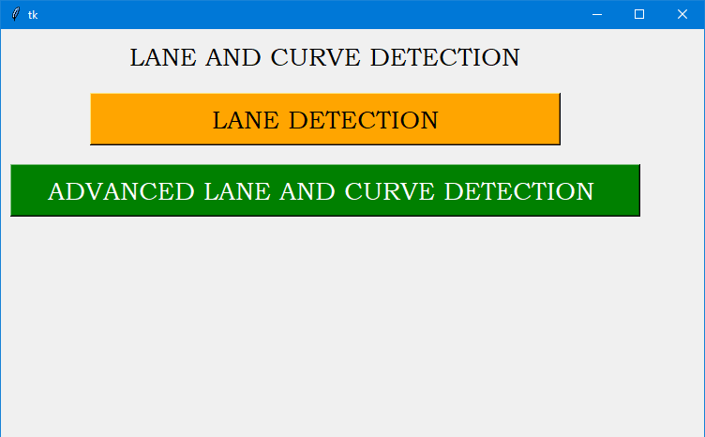
Screenshots

Slide 20
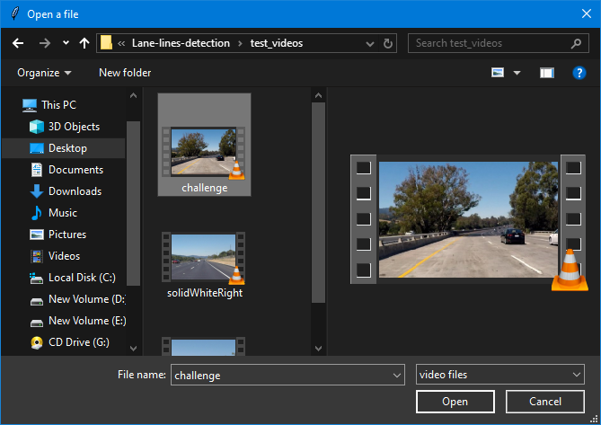

Slide 21
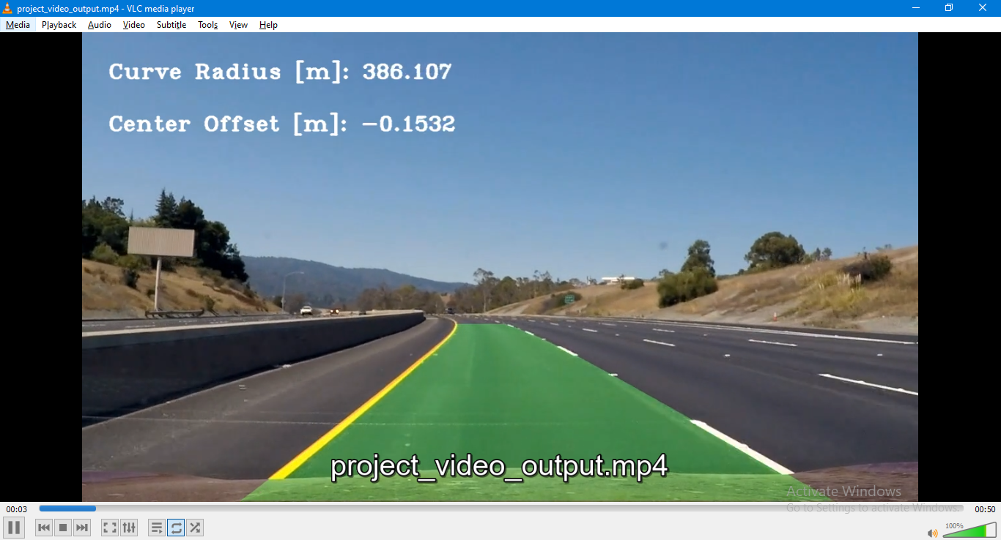

Slide 22
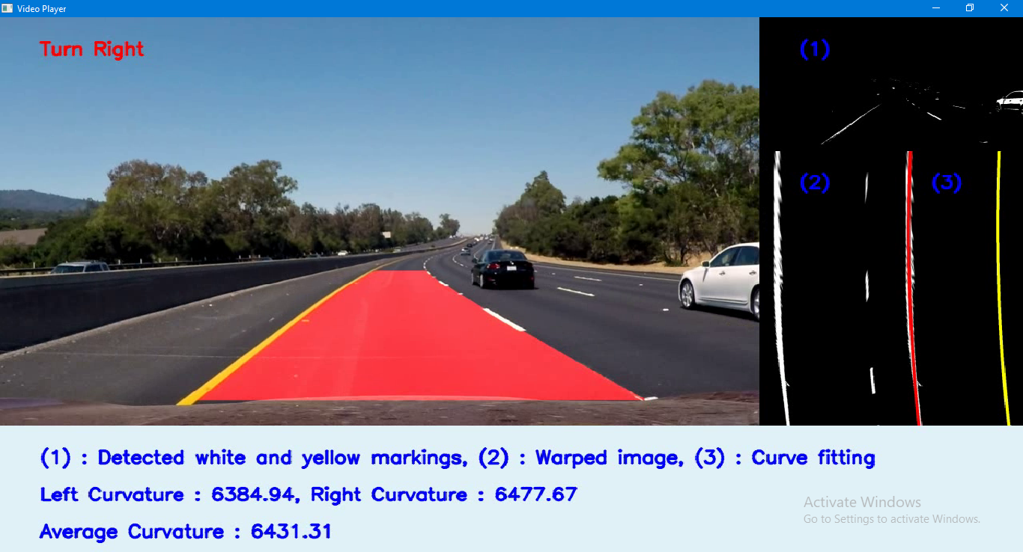

Slide 23
Conclusion
In this project, a novel hybrid neural network combining CNN and RNN was proposed for robust lane detection in driving scenes.
The proposed network architecture was built on an encoder-decoder framework, which takes multiple continuous frames as an input, and predicts the lane of the current frame in a semantic segmentation manner.
In this framework, features on each frame of the input were firstly abstracted by a CNN encoder.
Then, the sequential encoded features of all input frames were processed by a ConvLSTM.
Finally, outputs of the ConvLSTM were fed into the CNN decoder for information reconstruction and lane prediction.
Two datasets containing continuous driving images are constructed for performance evaluation.

Slide 24
.
Literature Survey
Author | Year | Paper | Algorithm & Features | Accuracy
Zillur Rahman et al., | 2023 | Deep Learning for Lane Detection and Classification in Challenging Conditions | Convolutional neural networks CNN Dataset : LVLane datasets | 97.89%
Qin Zou et al., | 2020 | Robust Lane Detection from Continuous Driving Scenes Using Deep Neural Networks | Hybrid deep architecture combining convolutional neural networks (CNN) and recurrent neural networks (RNN). | 98.5%

Slide 25
.
Literature Survey
Author | Year | Paper | Algorithm & Features | Accuracy
Manoj Kumar Sharma et al., | 2023 | Lane Detection Using Convolutional Neural Network And Recurrent Neural Network For Autonomous Vehicles | The proposed framework is evaluated on both CNN and RNN using a self-created dataset and BDD100K. | 97.91%
Rustam Abdrakhmanov et al., | 2023 | Mask R-CNN Approach to Real-Time Lane Detection for Autonomous Vehicles | the Mask R-CNN-based approach, making it an ideal solution for real-time implementation in autonomous vehicles for safe and efficient navigation. | 97.25%

Slide 26
.
Literature Survey
Author | Year | Paper | Algorithm & Features | Accuracy
Fareha Tabassum et al., | 2023 | Road Lane Line Detection System by Using Deep Learning | Hough line transform to detect and draw lanes, ultimately creating a blended image for improved lane visualization. It uses CNN and RNN Algorithms in this system. | 93.8%
Raviteja et al., | 2023 | Modelling a deep network using CNN and RNN for accident classification | The proposed D-RNN then analyzes feature representation from sample bags, achieving a superior trade-off in classification. | 92.9%

Slide 27
.
Literature Survey
Author | Year | Paper | Algorithm & Features | Accuracy
Zhang et al., | 2019 | A Fast Learning Method for Accurate and Robust Lane Detection Using Two-Stage Feature Extraction with YOLO v3 | Proposed is a two-stage YOLO v3-based adaptive lane feature learning algorithm, modifying structural parameters for lane detection. | 96.2%
Wang et al., | 2020 | CNN based lane detection with instance segmentation in edge-cloud computing | Proposes a dual model using convolutional neural networks for improved lane detection in varying scenarios, combining edge-cloud computing to enhance data processing efficiency. | 97.45%

Slide 28
.
Literature Survey
Author | Year | Paper | Algorithm & Features | Accuracy
Fareha Tabassum et al., | 2023 | A deep learning approach for lane marking detection applying encode-decode instant segmentation network | Introduces encode-decode instant segmentation network (EDIS-Net), a Deep Learning methodology for Lane Marking Detection (LMD) in diverse environments. | 97.39%
Al-Masrur et al., | 2022 | LLDNet: A Lightweight Lane Detection Approach for Autonomous Cars Using Deep Learning | Introduces LLDNet, a lightweight CNN model for lane detection, addressing challenges of real-world road variations and adverse weather conditions. | 94.2%

Slide 29
THANK YOU

